Slide 1
REVERSE-ENGINEERING TED NELSON
A hyper-adventure with your guide: Eric Rangell
KansasFest 2020

Slide 2


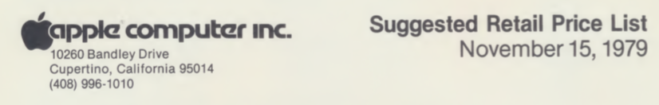
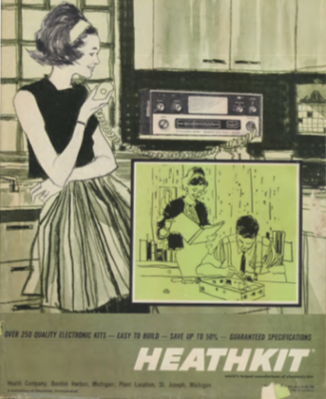
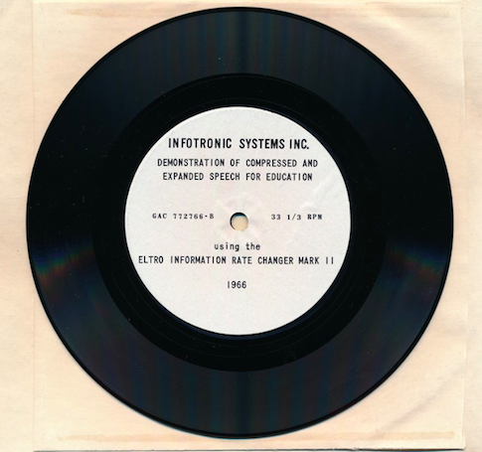
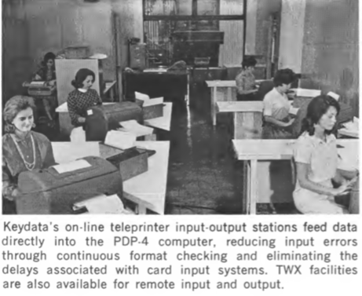
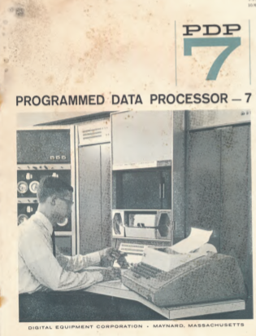
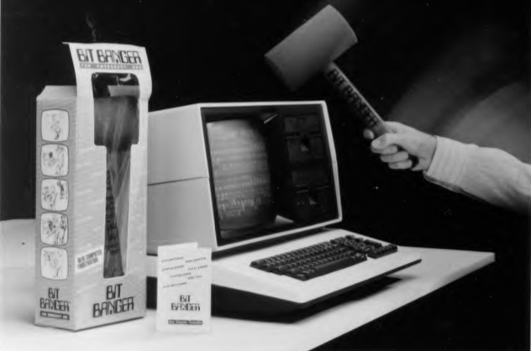
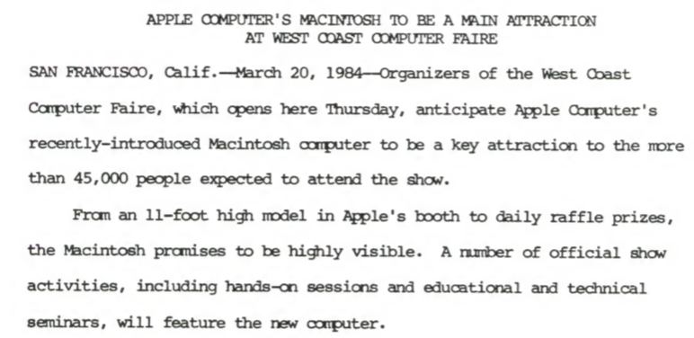
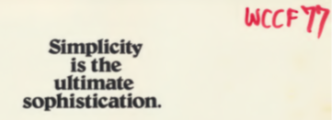
Who is Ted Nelson?
And why did we donate to scan his junk mail to the Internet Archive?

Slide 3
Ted Nelson: Main Accomplishments
Inventor of the Back Button! (against his co-workers’ objections)
Created the first Rock Musical in 1957, a computer themed soap opera, and a student film about the meaning of life. (Enjoy his YouTube channel!)
Coined the word “Hypertext” in 1962, and many other words.
His book Computer Lib encouraged Steve Wozniak to develop the Apple 1.
Designed a word processor used by NASA for Apollo mission documents.
Designed full hypertext systems with visible connections to source material.
Designed a multi-dimensional database structure that subsumes all others.

Slide 4
OK, how do we reverse-engineer him?
Watch his Youtube videos
Read his autobiography: Possiplex
Read his letter to Brewster Khale from Jan 18, 2011: (HTbrew-D11)
“Where My Hypertext Ideas Came From and Where They All Went”
Read his junk mail – Thanks Jason and Kevin, and all who donated!
Dig up Sunless Sea on archive.org

Slide 5
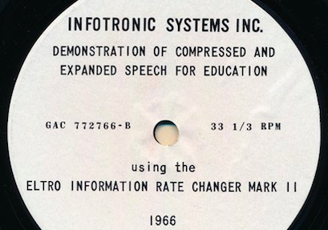
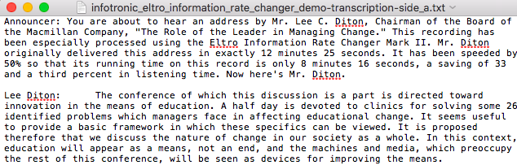
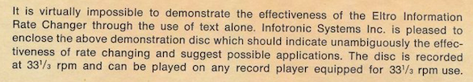

Just one of the gems in Ted’s junk mail

Slide 6
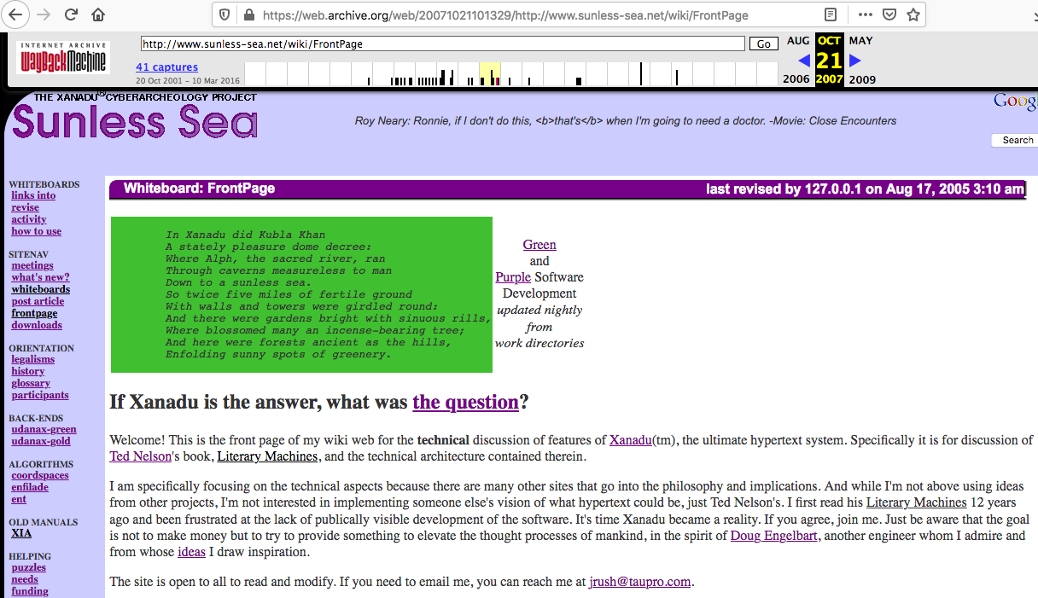
Sunless Sea: Xanadu Cyberarchaeology Project (last revised August 17, 2005)

Slide 7
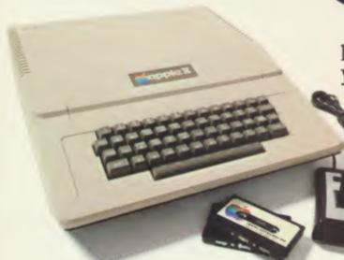
What does this have to do with
?
Ted adapted his 1972 design of the JOT ™ (Juggler of Text) writing system to create a product for the Apple II computer in 1982, which was rebuilt in 1986 by Steve Witham and is now available on the Internet Archive.
The 1972 system was designed for a teletype and tape storage. Ted designed a storage system where the text characters never moved – only pointers to spans of characters were changed as the document was edited.

Slide 8
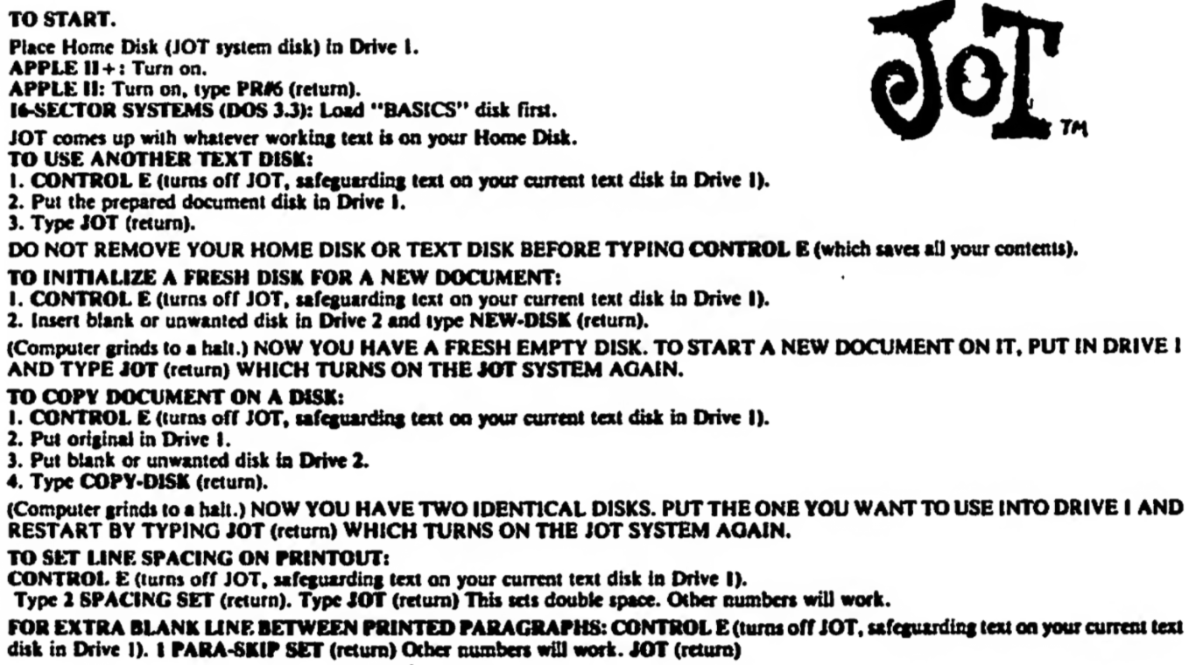

Slide 9
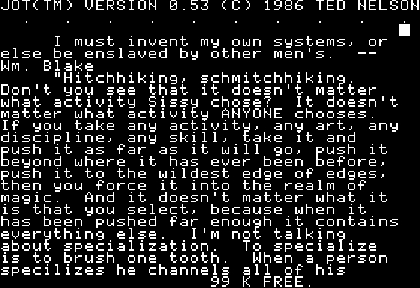
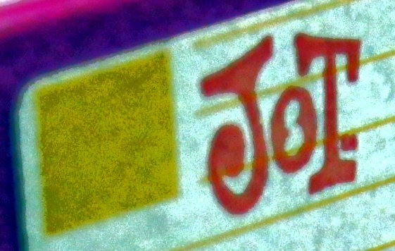
DEMO: JOT ™ User Interaction

Slide 10
Document = Text + Pointers
Continuous versioning of the document – can reconstruct old versions.
1.0 = “It was a dark and stormy night” (position 0, length 30)
Change word “stormy” to “rainy”
1.1.1 = “It was a dark and ” (position 0, length 18)
1.1.2 = “rainy” – word appended to tape. (Position 31, length 5)
1.1.3 = “ night” (position 23 length 6)

Slide 11
JOT™ 1986 is written in Forth 1.7
Forth is a Threaded Interpretive Language. Some people call it a “write-only” language because the code can look very cryptic.
Forth has very low level access to the computer, runs very fast, has a small memory footprint, and been primarily used for controlling machinery.
The entire image of a Forth system can be saved and loaded, like Smalltalk.
Forth is fun to use. Mad Apple Forth is a Prodos version of Forth. The Plasma language was derived from Forth.

Slide 12
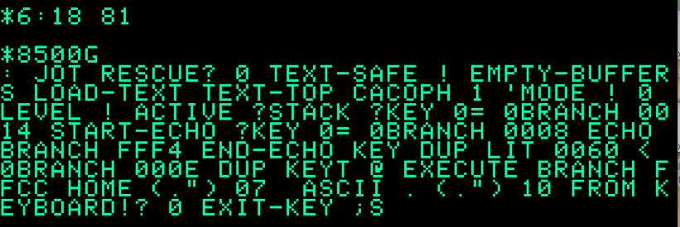
An Ancient Incantation From 1986

Slide 13
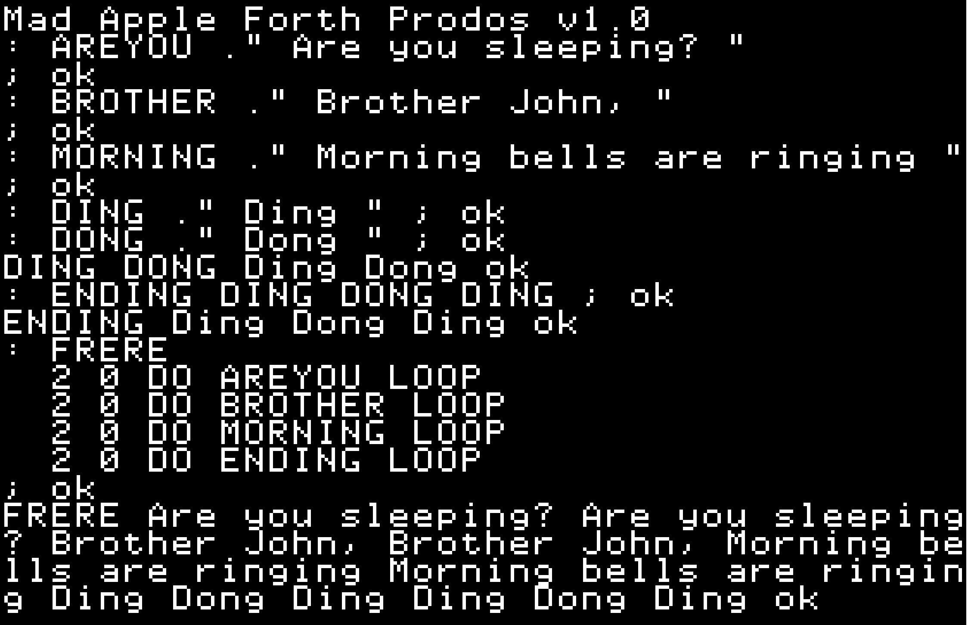
DEMO: Coding in Mad Apple Forth

Slide 14
Reverse Engineering JOT™
The disk image has standard RWTS, but the Forth code is “unlistable”.
Some Forth words have extra bytes, and pointers to most words are null.
1. Write program to find as many Forth words and addresses as you can.
2. Identify patches to fix the bad words.
3. Write program to fill in the null pointers with the correct values.
4. Get a complete list of the Forth words and their starting addresses.
5. Disassemble the Forth words – use the emulator’s printer to get them into a PDF.
6. Read the code. Edit generated structures. Port to Mad Apple Forth.

Slide 15
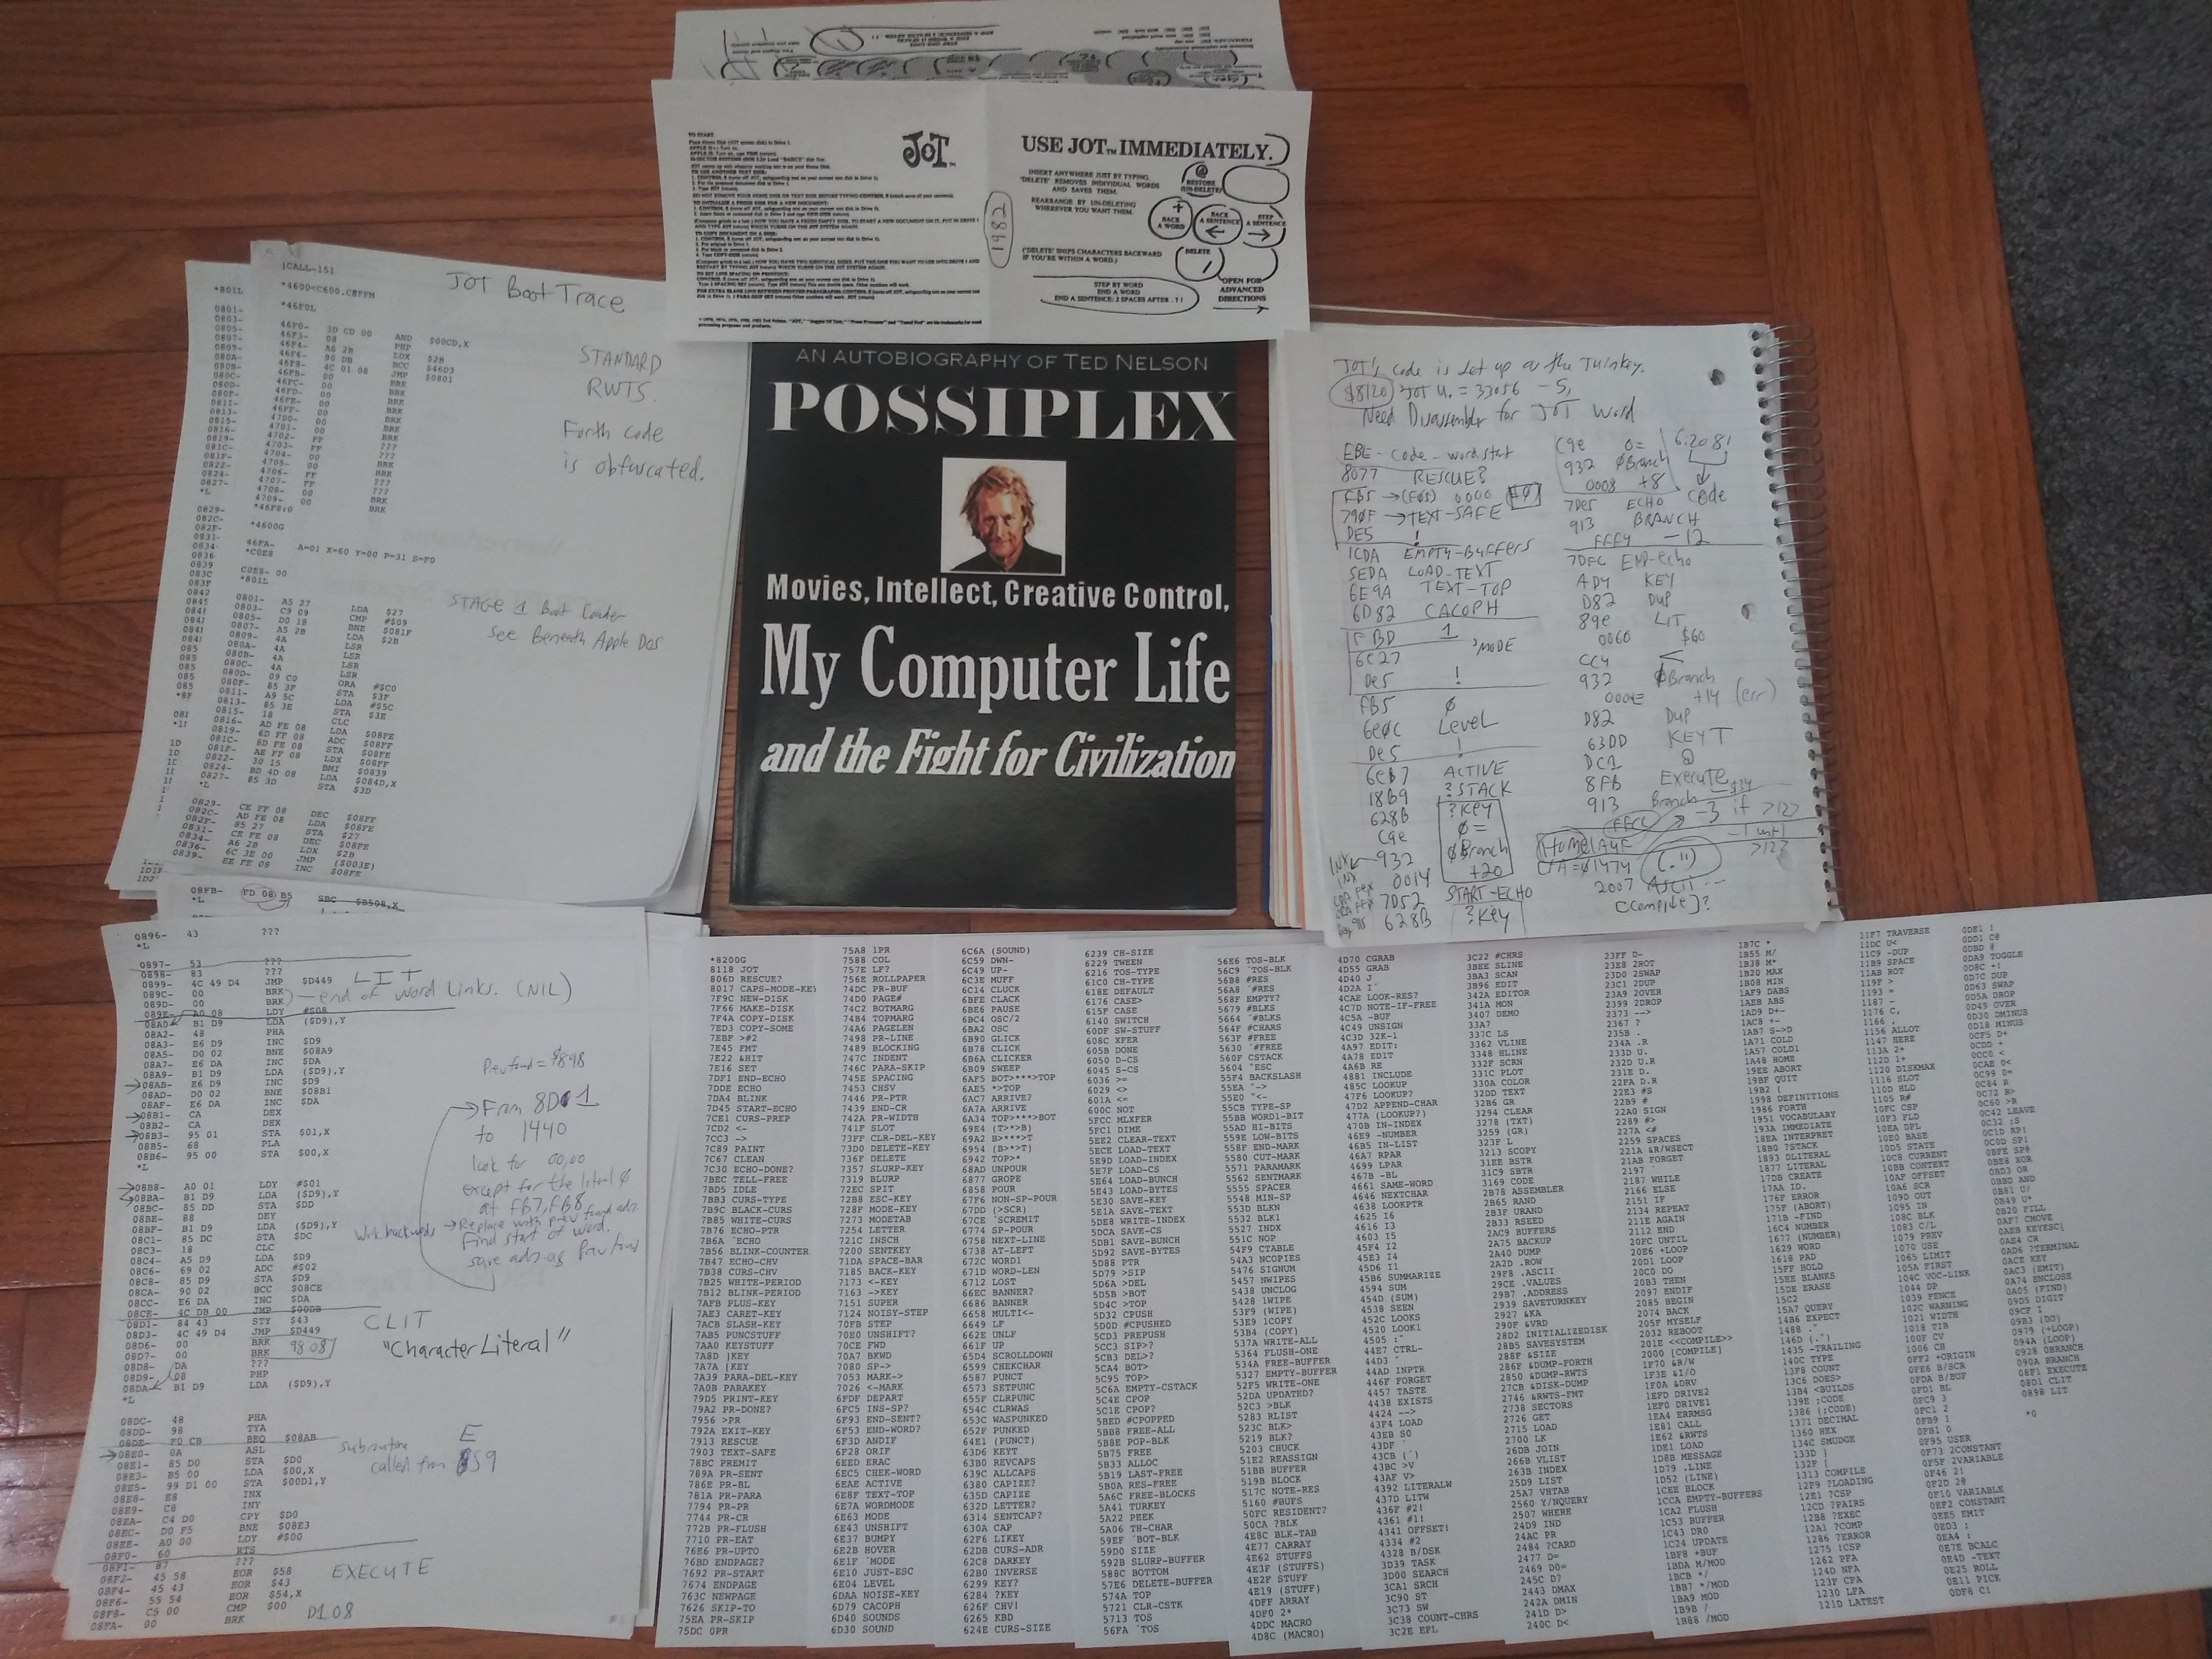

Slide 16
If you get frustrated, find this on eBay:

Slide 17
DEMO: Reverse Engineering JOT™
Using an emulator (especially Virtual II) makes the process easier.
Monitor and Mini-Assembler commands can be pasted from text files.
Use the emulator’s breakpoints and debugger as needed.
Use the emulator’s printer to save output to PDF files.
Print hardcopy when needed and take notes on what you find.
Goal: An annotated source code listing of the JOT system.

Slide 18
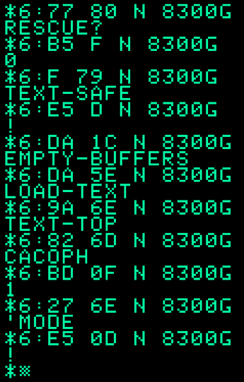
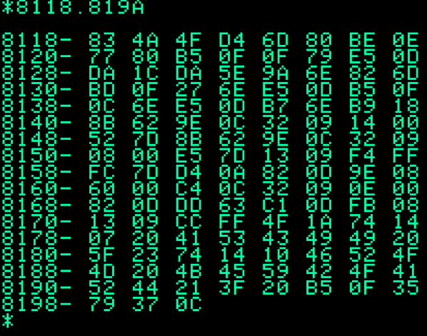
Structure of a Forth Word

Slide 19
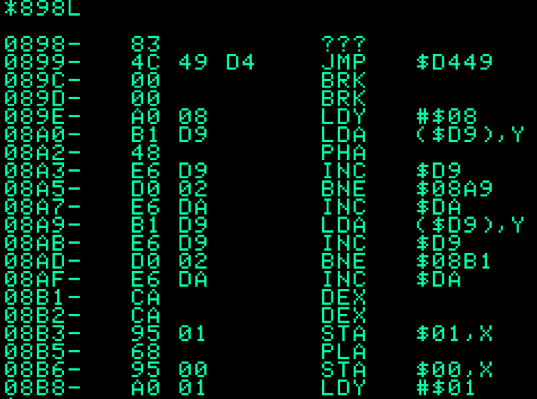
The lowest level words have machine code
83 = Length of name of the word (AND #$3F)
4C 49 D4 = “LIT” Last byte has high bit set.
00 00 = pointer to previous word. (LIT is the very first word in the system)
A0 08 = pointer to code for the word (immediately following indicates machine code)
8A0 = machine instructions

Slide 20
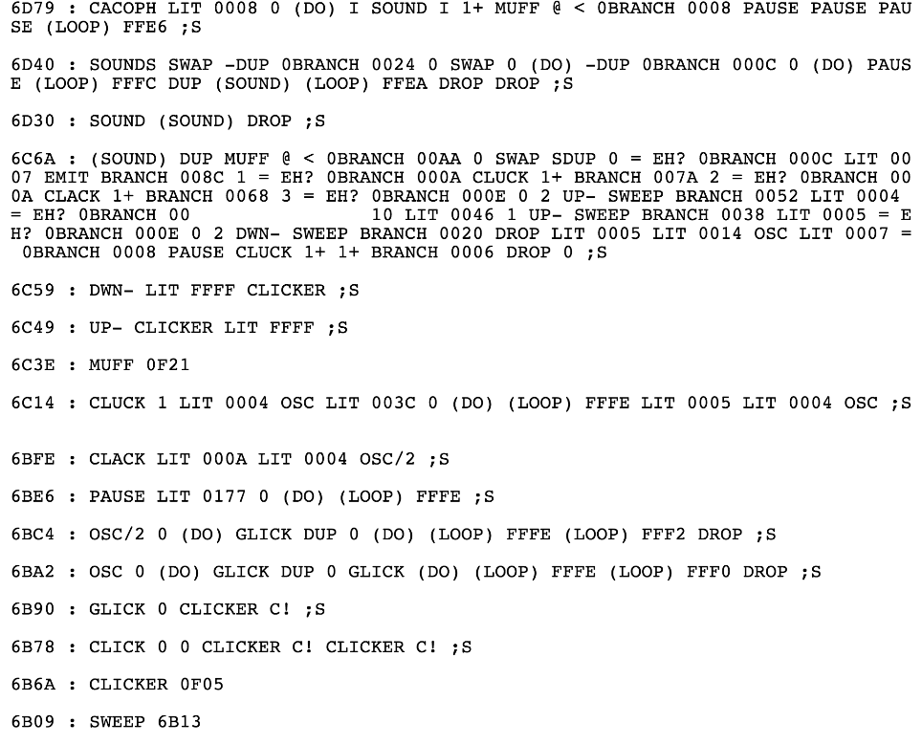
Demo: Let’s start by grabbing the sounds!

